Slide 1
Analysis of Job Advertisements in Social CRM industry
Jhanvi Lotwala

Slide 2
Problem Definition
Text Analysis in Job Postings
Identify knowledge and skills
Mapping the competencies in the frequently changing job market
Insight on Social CRM industry
Helpful in job search and recruitment

Slide 3
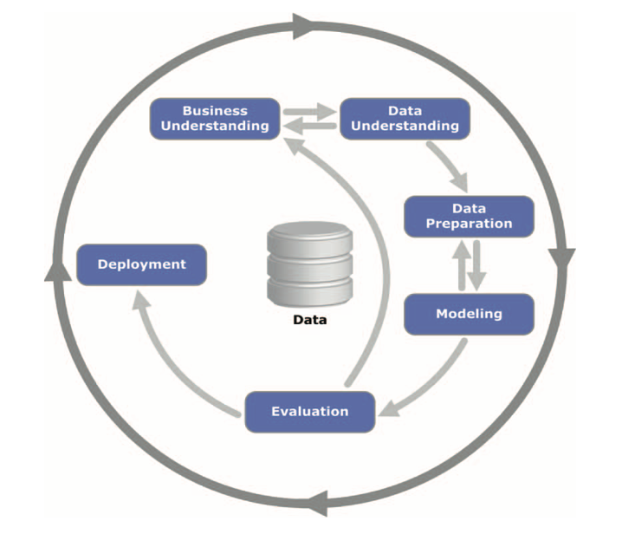
Baseline
N vmb m
Dataset variables: job id, job title, job requirements, job summary, job tasks; rows: 1296

Slide 4
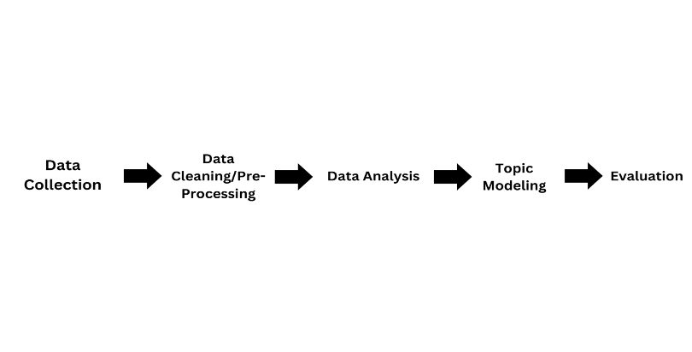
Data Cleaning/Preprocessing
Removal of duplicates based on id and pageUrl
Conversion of non-English ads
Removal of common English stop words and some additional stop words like “view”, “e g”, “please”, “send”, “end”, “de”, etc.

Slide 5
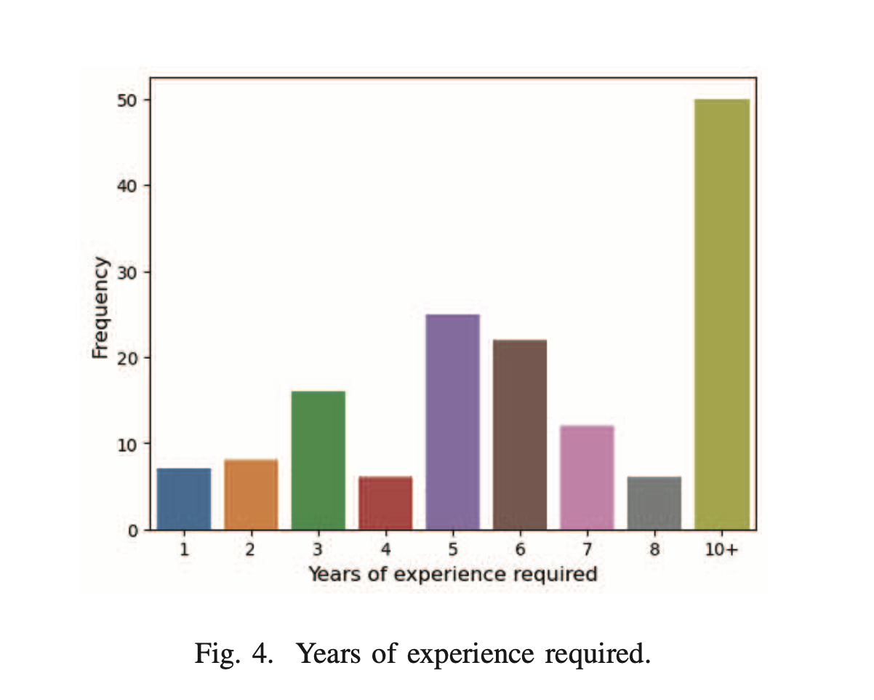
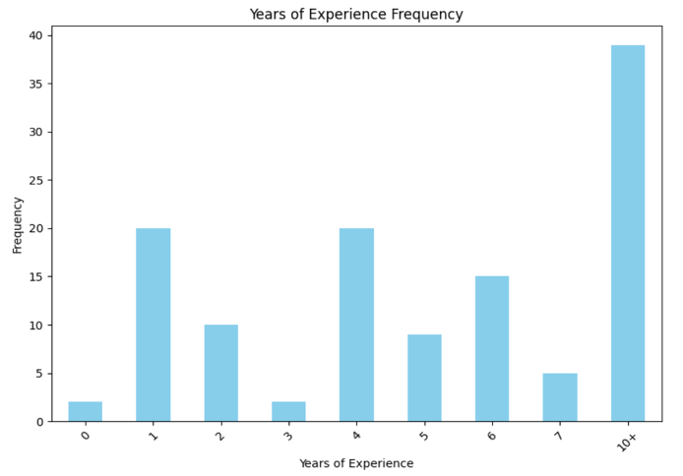
Data Extraction

Slide 6
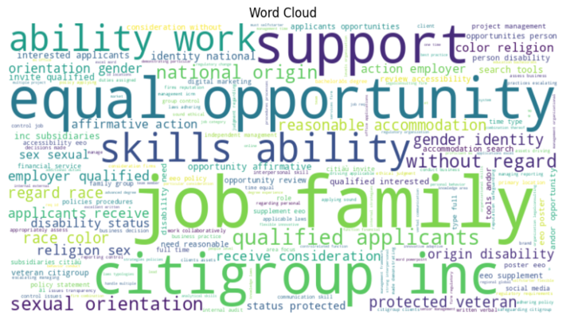
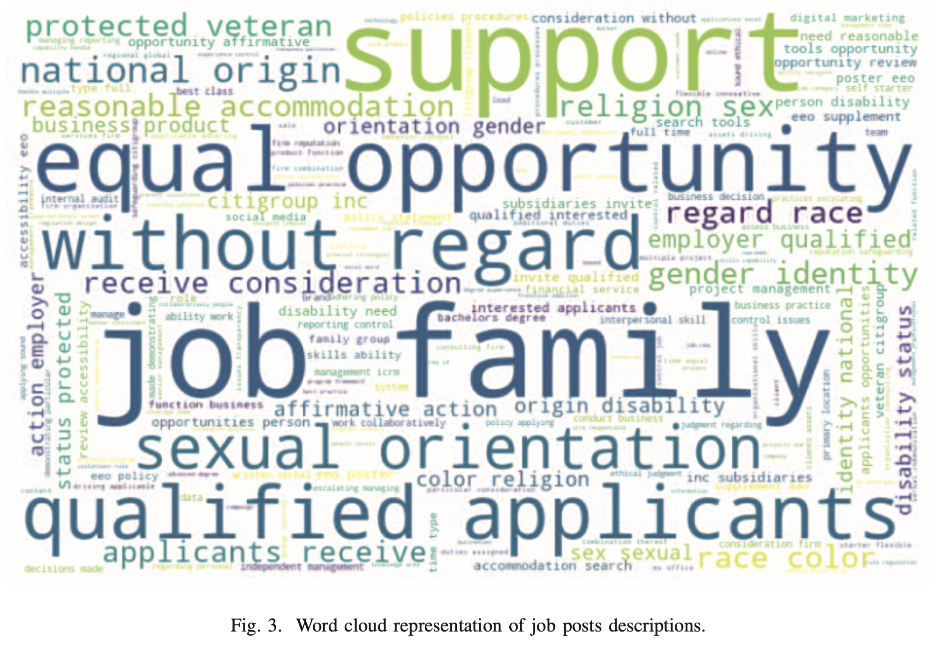
Word Cloud

Slide 7
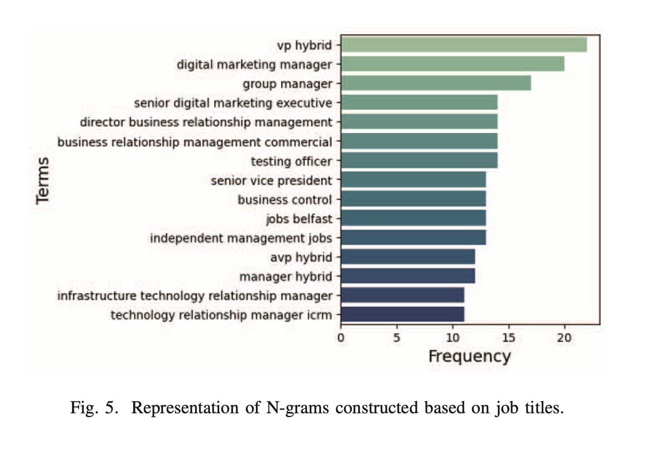
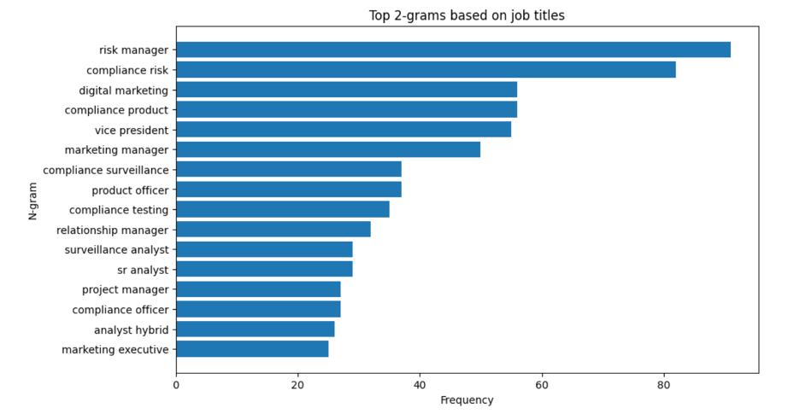
N-grams

Slide 8
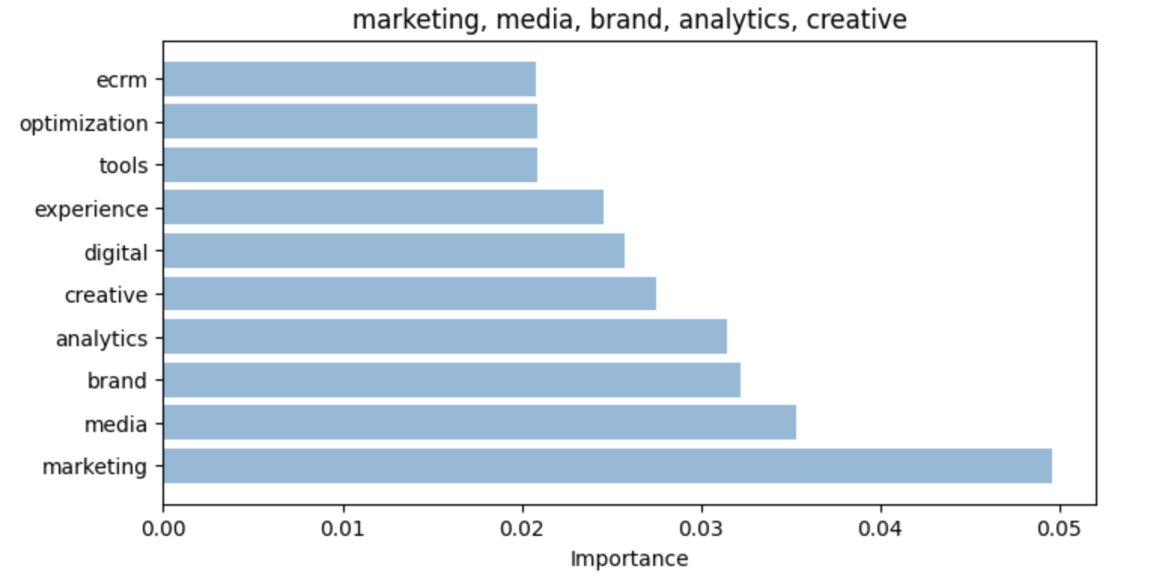
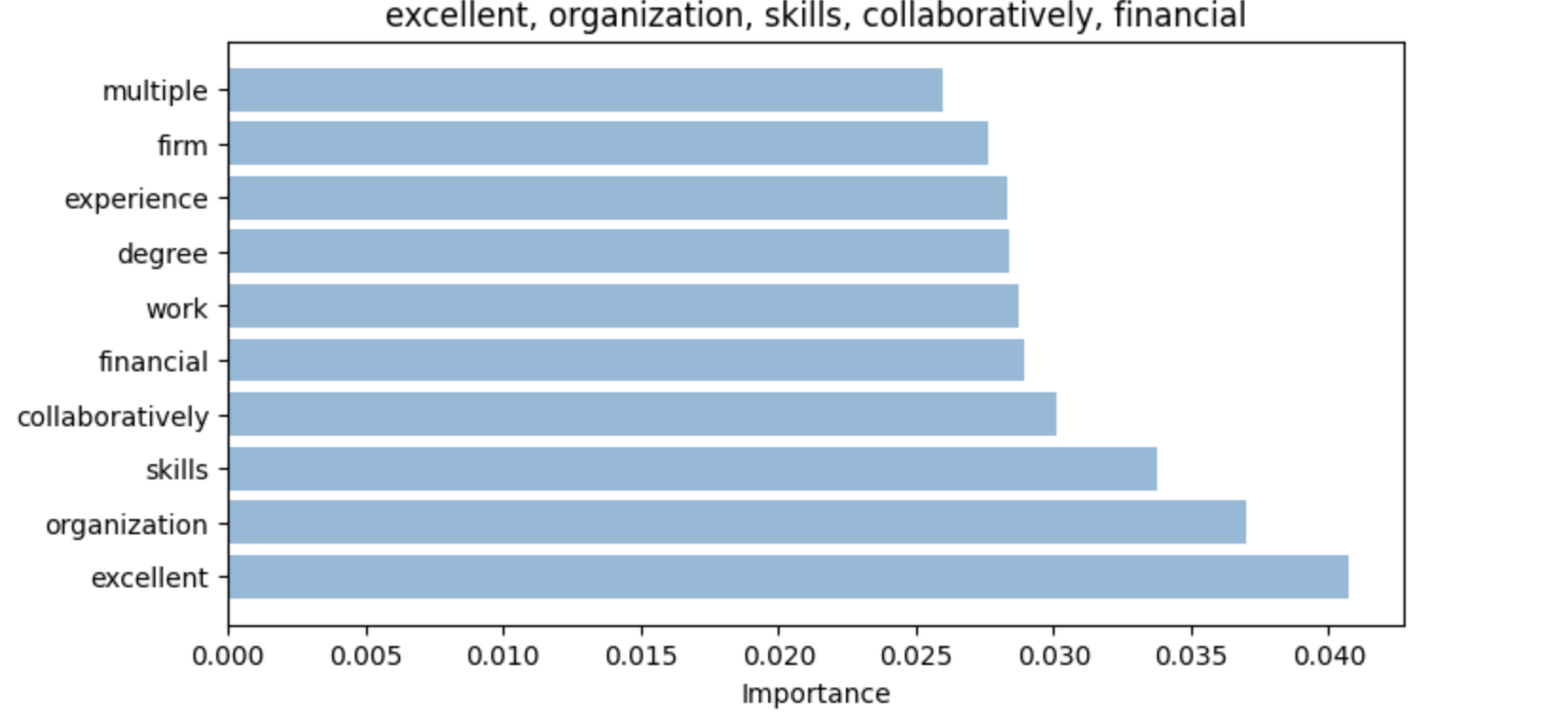
BERTopic Modeling

Slide 9
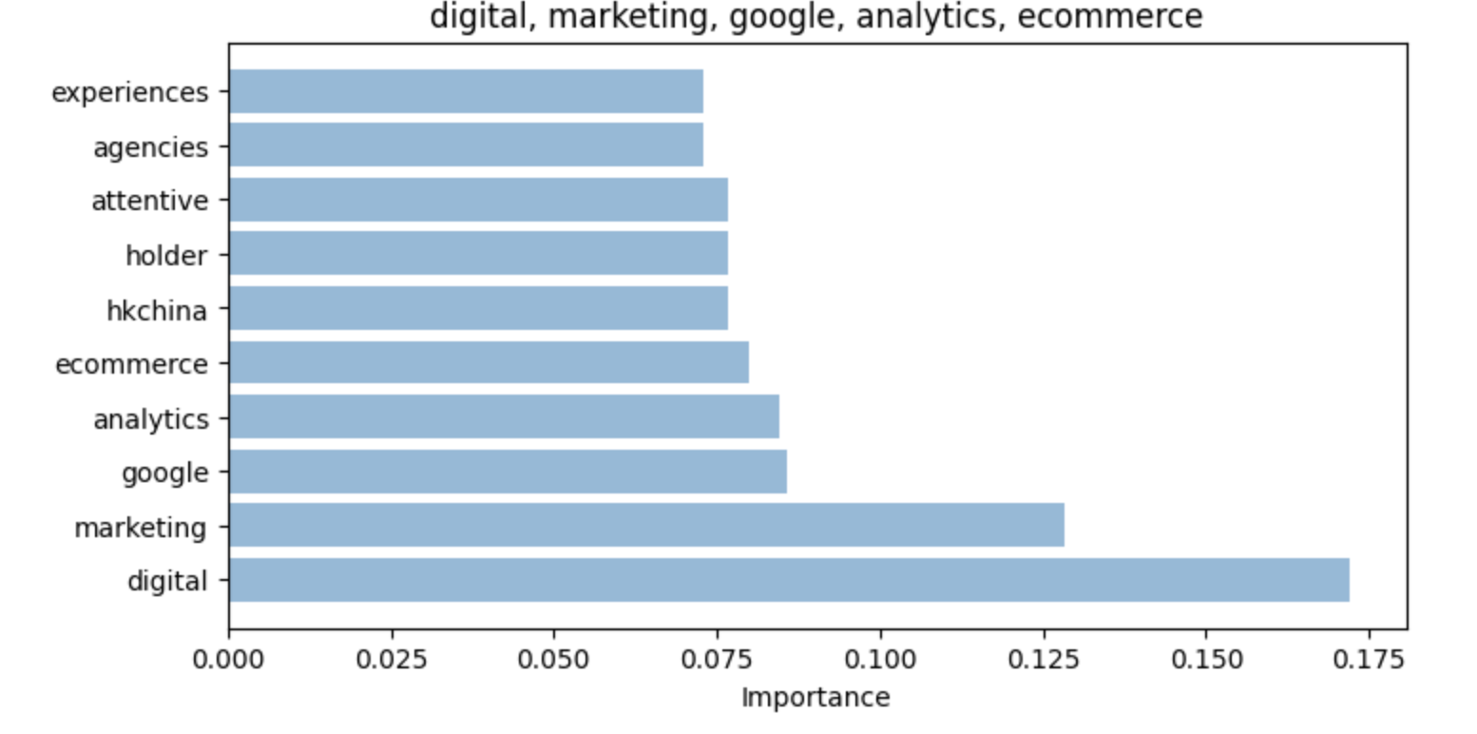
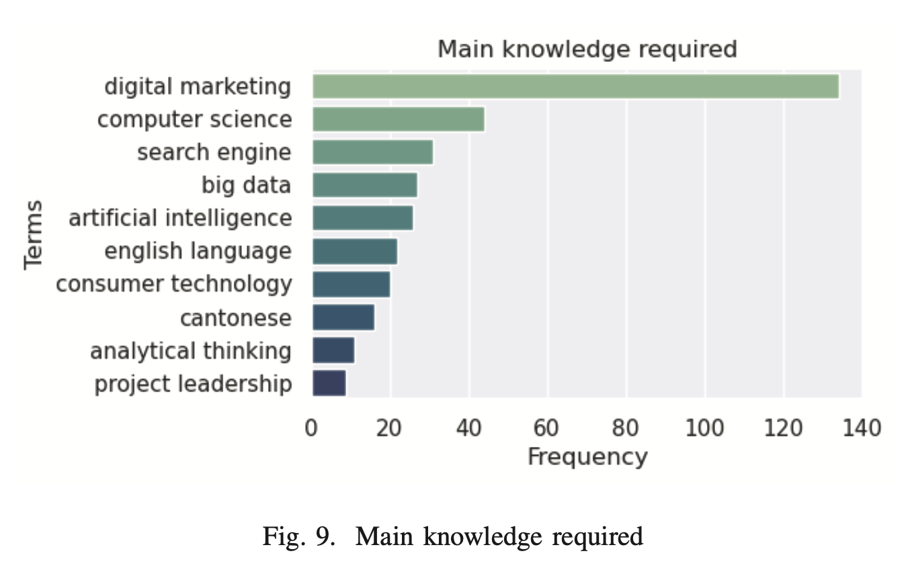
BERTopic Modeling

Slide 10
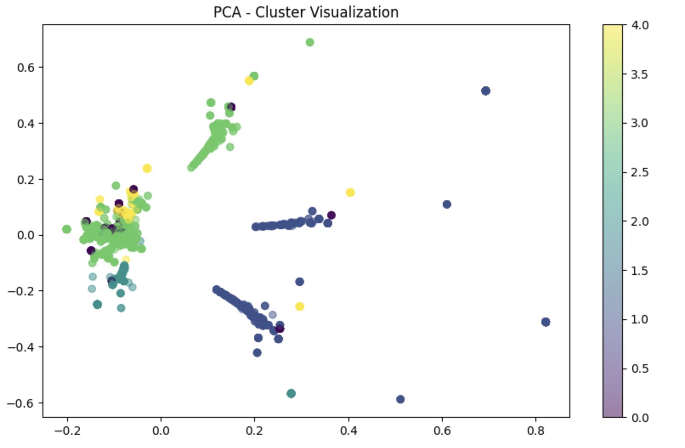
Clustering w/ Dimensionality reduction

Slide 11
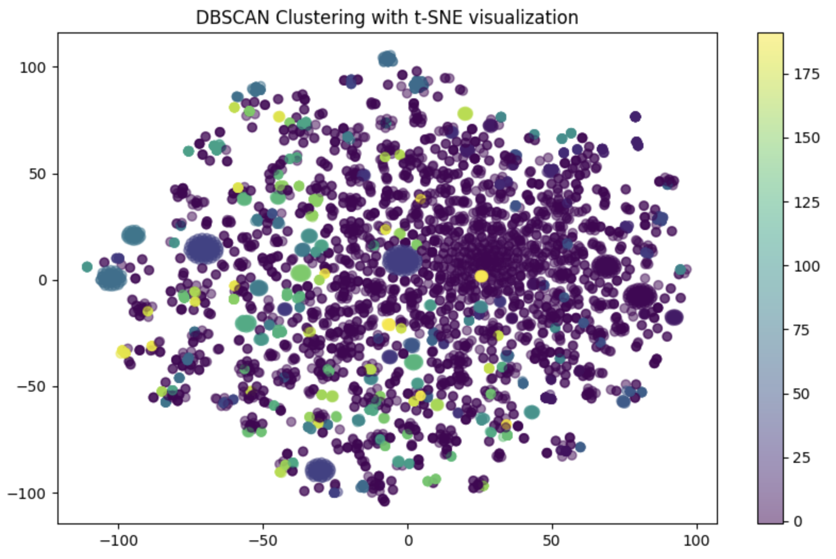

Slide 12
Evaluation/Discrepancies
N-grams, Word Cloud, and, Years of Experience showed good results
Evaluated each text column
Baseline Approach: BERTopic Modeling
New Approach: Clustering along with dimensionality reduction techniques
Scraped data had some rows with neither English nor any other language
Some noise reduction needs to be done manually

Slide 13
References
[1] P. C. Menezes, A. F. Justino, B. A. Barata, A. F. Jacob Junior and F. M. Lobato, "Market Overview in Social CRM: An Analysis of Job Advertisements," in 2023 IEEE/WIC International Conference on Web Intelligence and Intelligent Agent Technology (WI- IAT), Venice, Italy, 2023, pp. 555-562, doi: 10.1109/WI-IAT59888.2023.00092. keywords: {Industries;Social networking (online);Taxonomy;Customer relationship management;Companies;Market research;Intelligent agents;Data Analysis;Social CRM;Job Analysis;Text Mining;Market Analysis}
[2] A. Mueller, “wordcloud,” PyPI, Jul. 26, 2018. https://pypi.org/project/wordcloud/
[3] M. P. Grootendorst, “Home,” maartengr.github.io, 2022. https://maartengr.github.io/BERTopic/index.html#quick-start

Slide 14
Thank You for listening:)

